Slide 1
Unit Plan
Week 1

Slide 2
Welcome to Week One!

Slide 3
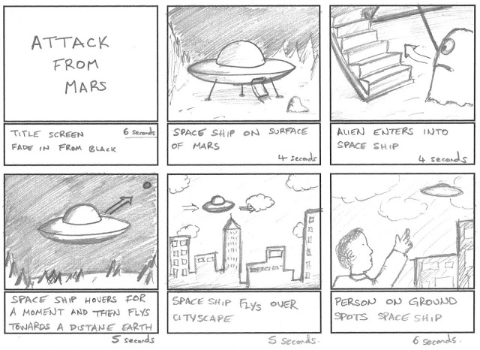
What is a Storyboard?
A Storyboard is a plan of action for any sort of performance based project.
It helps line out What you want to do, How you are going to do the action, and When you are going to act upon a set action.
Think of it like a step by step of what to do and what action to take next to complete your goal!

Slide 4
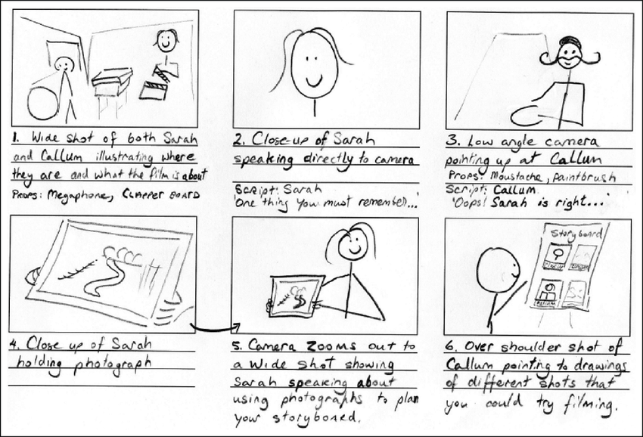
What do You Need for a Storyboard?
Physical cues; these are things like taking steps forward, gesturing towards an object, or physical activity you plan on doing while recording.
Visual cues: Hand movements, facial expressions, and any other body language you want to use can be added.

Slide 5
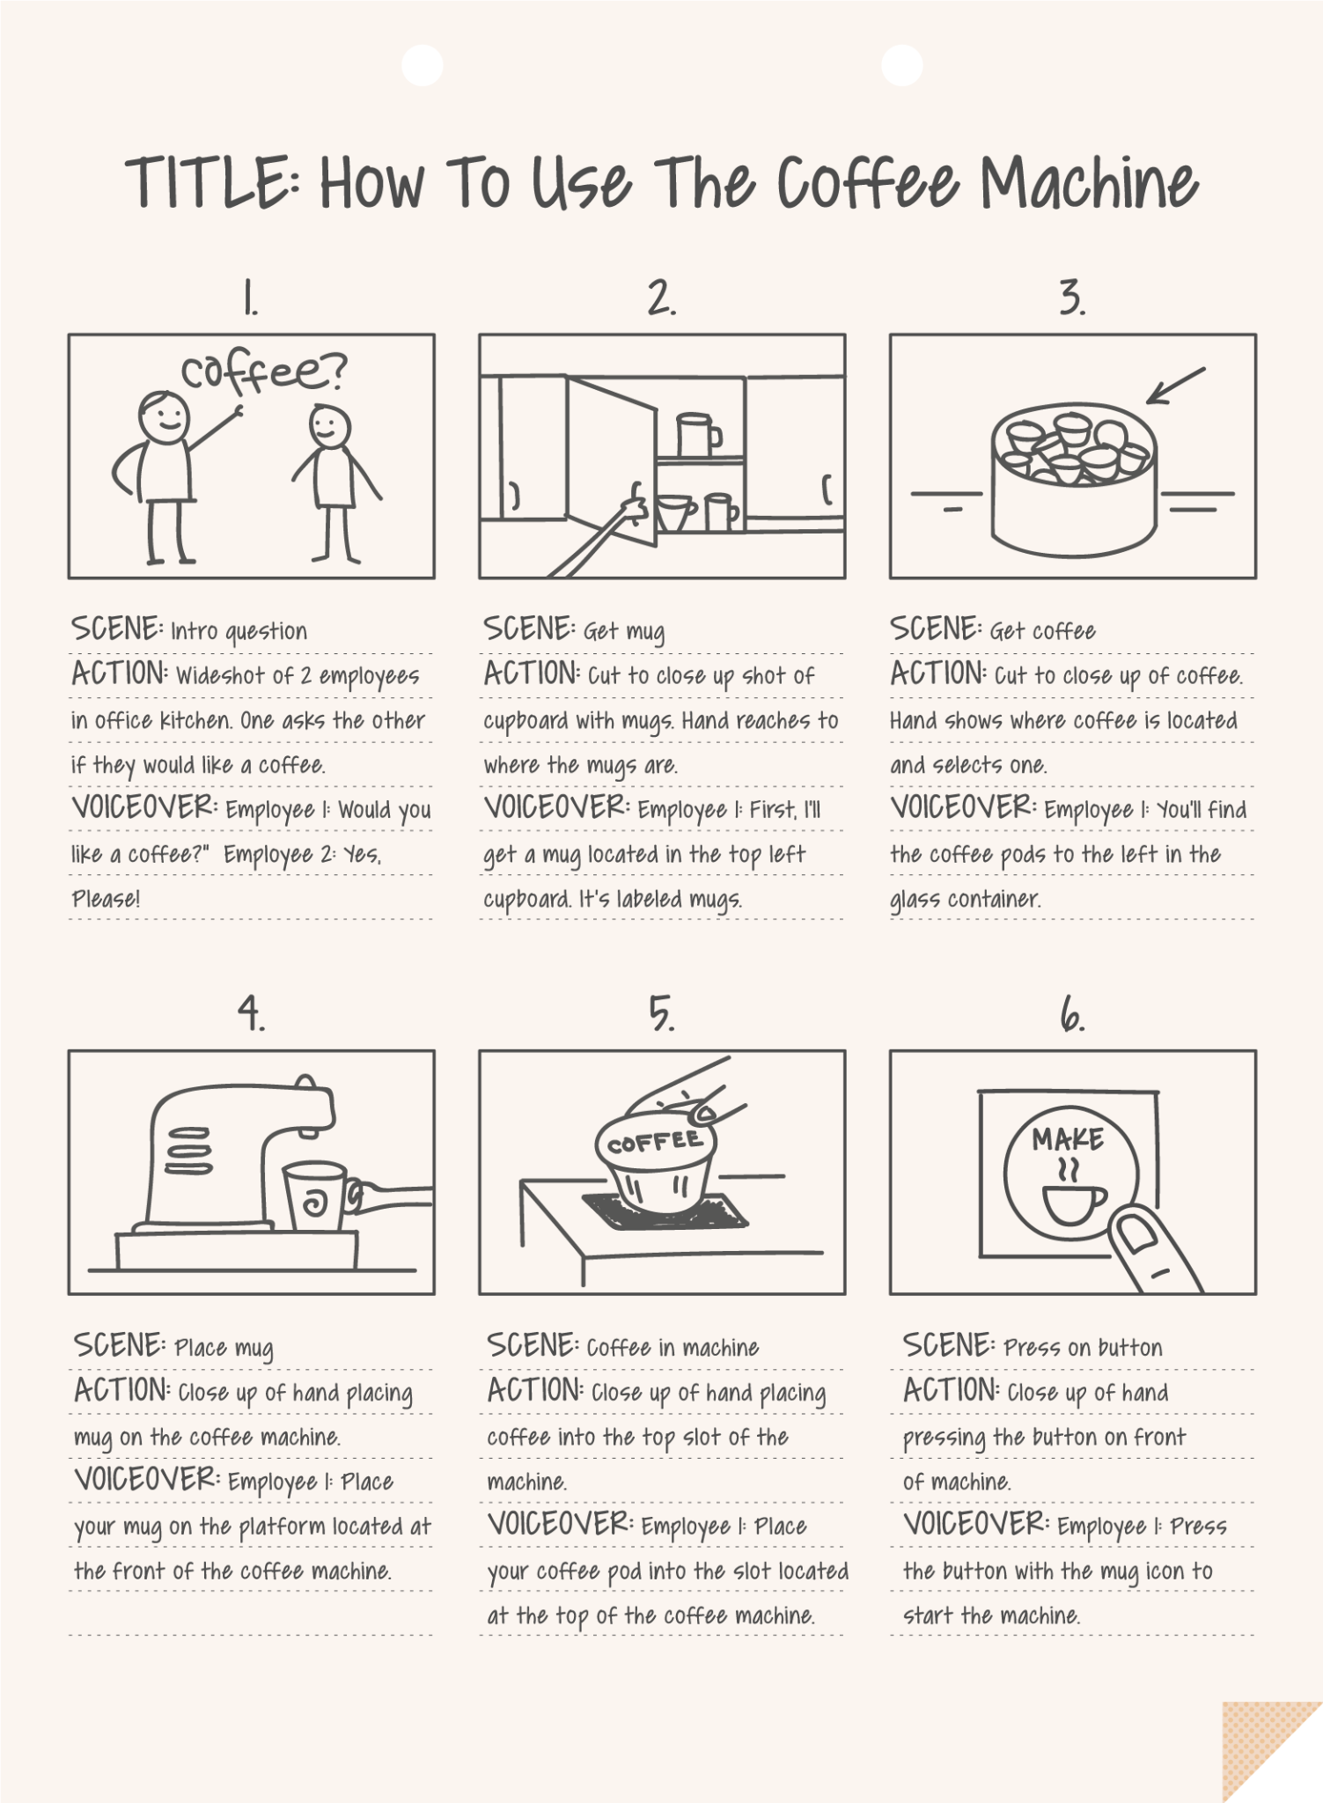
Examples of Good Storyboards:
Things that make this a good example:
Details on Scenery
Details on Actions being taken by actors
Details on camera shots
And details on Voiceover/ script scenes

Slide 6
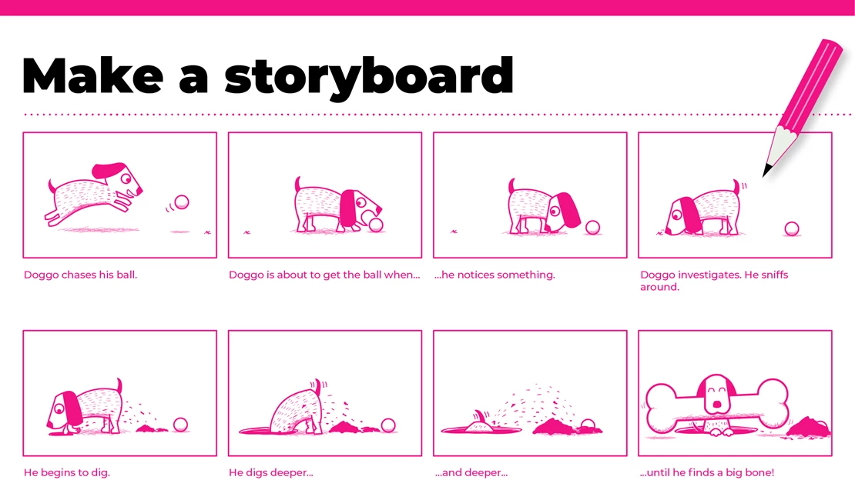
Effective Vs. Ineffective Storyboards:
Is the Storyboard that you see here a effective use of storyboards?
Discuss with your table:
Why or why not is it effective?

Slide 7
Effective Vs. Ineffective Storyboards
Is the Storyboard that you see here an effective use of storyboards?
Discuss amongst the people at your table.
Why or why not is it effective?

Slide 8
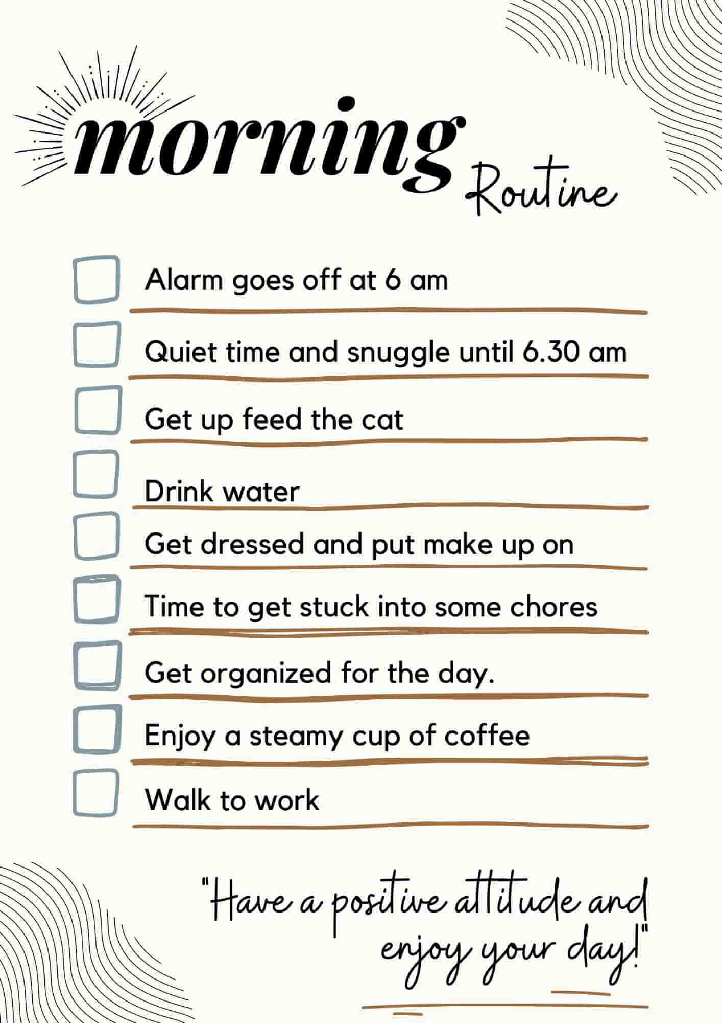
April 3rd Goals:
Begin working on a storyboard of your morning routine; this will be an example work before getting into the project.
If you have any questions or concerns let one of us know! :)

Slide 9
April 4th Goals:
Watch two videos provided with the class.
Fill out the assignment provided to you with your groupmates.
Link #1 Video:
Link #2 Video:

Slide 10
April 5th Goals:
Talk to your groupmates about storyboarding:
What segment(s) are you each going to work on (weather, world news, health, etc.)?
What do you want to convey to the audience? Whats happening in your news segment that you’ll be telling people?
Storyboards & Script writing is due before you can begin filming your project! :)

Slide 11
Welcome to Week two!

Slide 12
Class Resources:
There will be a demo video (starring us!) to watch to get a feel for the formatting, editing, and different transitions you can use.
Videos from the CNN 10 to get ideas from:)
MadLip Scripts; fill in the blank scripts for you all to use to help with your storyboards and filming!

Slide 13
April 8th-9th Goals:
For the next few days, you all will be working in small groups of 3-4 students
In these groups you all will be working on your storyboards, scripts, and building any other ideas for your videos before filming
If you have any questions or concerns during this time, raise your hand or call one of us over to help, we are more than able to! :)

Slide 14
April 10th-12th Goals:
During this time, those who are ready to will begin filming
However! First make sure to go over all the equipment you will be using and how to use it ( Microphones, props, etc.)
Filming is going to take longer than you might expect, it will take more than one take most of the time but don’t worry! You have plenty of time to film more than once.

Slide 15
Welcome to Week three!

Slide 16
Materials You’ll Need:
Microphones; we will pass those out in a moment, test them while filming for any issues.
Props: Bring in any props or use any props around the room that you might want to use while filming( Be creative!)
Outfits: Try to wear something nice for your filming day, don’t dress in a full suit or fancy dress but business casual would be best!
Your outfits can also be used as props if you would like to ‘dress up’ as one!

Slide 17
April 15th-19th Goals:
Continue to work on filming individual videos for the project
If you have any questions or concerns let one of us know!
Begin building on ideas of what you would like to edit into your projects
(any emojis, transitions, voice changers, etc.)

Slide 18
Welcome to Week four!

Slide 19
OneShot Editing :)
Go to your google classroom and find the link for OneShot
Click on the Oneshot link and begin downloading the app (we will help direct this from the board)
Once downloaded look up to the screen were we will begin to demonstrate how and what to use from there!

Slide 20
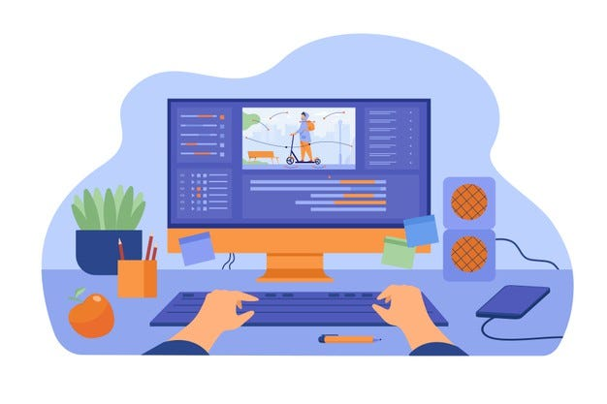
April 22nd Goals:
Go into your google classroom and open up the OneShot link, from there we will download the app and follow the instructions on the How-To for the app.
Today will be a Intro into how to use OneShot that we will be demoing together in class, if you need help or have any questions on editing we are here to help!

Slide 21
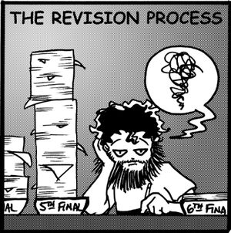
April 23rd-26th Goals:
You all will work on editing your videos from last week, adding any transitions, emojis, etc.
Make sure to talk to your groupmates on editing, talking to eachother about transition ideas
Add transitions between each video, and any other things you want to add together

Slide 22
Welcome to the Presentation(s) Day!!

